Slide 1
SPS-5717-Breast Cancer Risk Prediction System
Dr. Manik Ghosh
Department of Pharmaceutical Sciences and Technology
Birla Institute of Technology
Mesra, Ranchi - 835 215

Slide 2
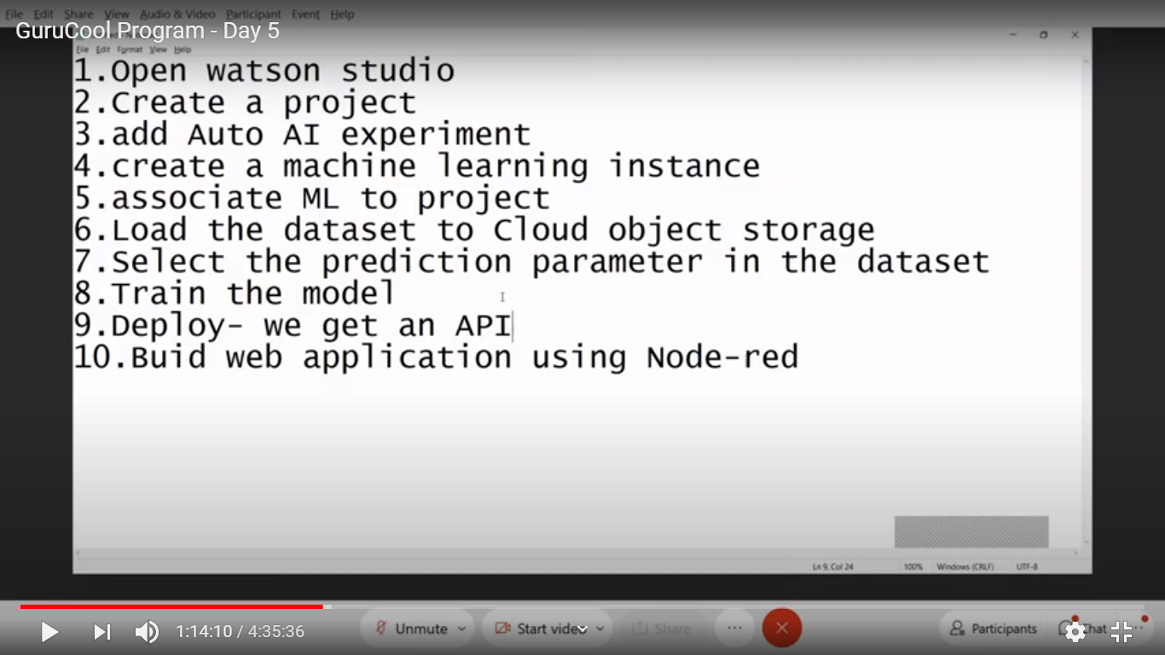

Slide 3
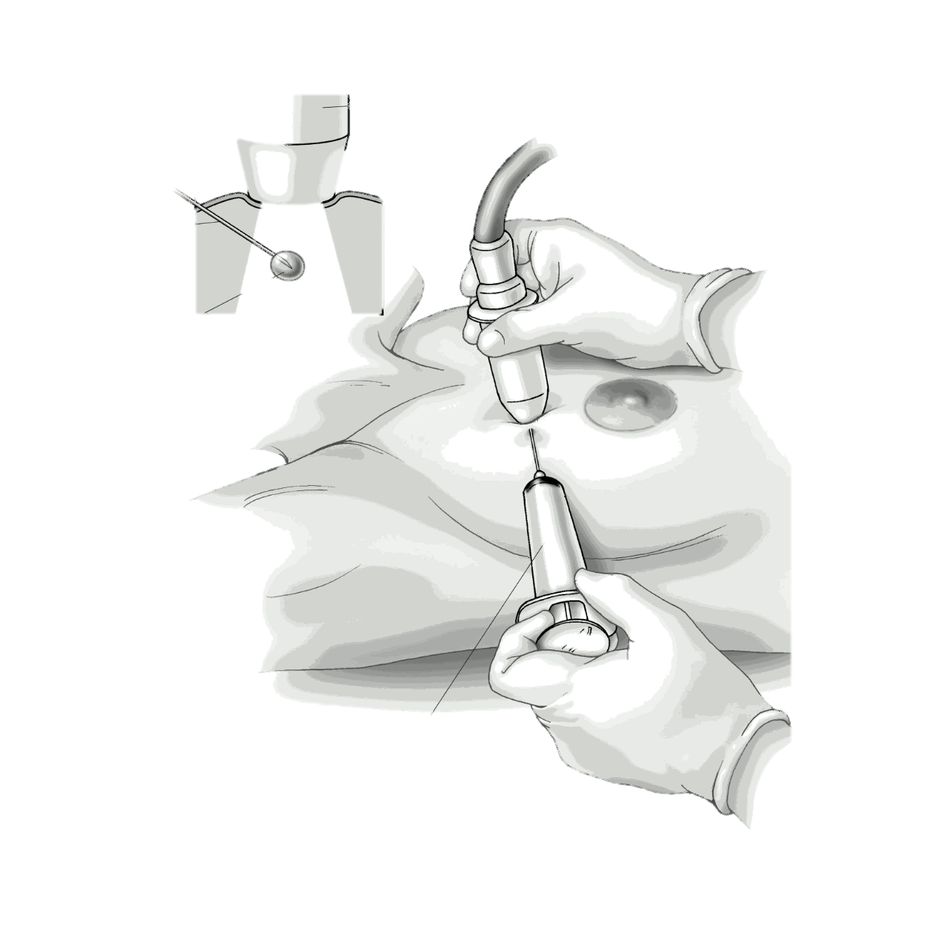
Data from Microscopic Biopsy
As mentioned in UCI website, “Features are computed from a digitized image of a fine needle aspirate (FNA) of a breast mass. They describe characteristics of the cell nuclei present in the image”.
Moreover, FNA is a type of biopsy procedure where a very thin needle is inserted into an area of abnormal tissue or cells with a guide of CT scan or ultrasound monitors (figure). The collected sample is then transferred to a pathologist to study it under a microscope and examine whether cells in the biopsy are normal or not.

Slide 4
Breast Cancer
Worldwide, breast cancer is the most common type of cancer in women and the second highest in terms of mortality rates. Diagnosis of breast cancer is performed when an abnormal lump is found (from self-examination or x-ray) or a tiny speck of calcium is seen (on an x-ray). After a suspicious lump is found, the doctor will conduct a diagnosis to determine whether it is cancerous and, if so, whether it has spread to other parts of the body.
This breast cancer dataset was obtained from the University of Wisconsin Hospitals, Madison from Dr. William H. Wolberg.
357 observations which account for 62.7% of all observations indicating the absence of cancer cells, 212 which account for 37.3% of all observations shows the presence of cancerous cell.

Slide 5
Total Data: 569
63% : Absence of Cancer
37% : Presence of Cancer

Slide 6
Total Data: 569
mean_radius: 14.1±3.52 Median: 13.4 (6.98 – 28.1)
mean_texture: 19.3±4.3 Median: 18.8 (9.71 – 39.3)
mean_perimeter: 92±24.3 Median: 86.2 (43.8 – 189)
mean_area: 655±352 Median: 551 (144 – 2500)
mean_smoothness: 0.1±0.01 Median: 0.1 (0.05 – 0.16)

Slide 7
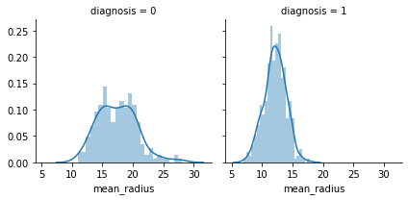
Radius
We can see that when mean_radius is close to 12 it is likely to be breast cancer and after 20 there is almost no chance to be breast cancer

Slide 8
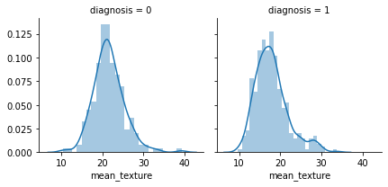
Texture
We can say that when diagnosis is 1 mean_texture is likely to be closer to 18 while at diagnosis=0 mean is at near 21

Slide 9
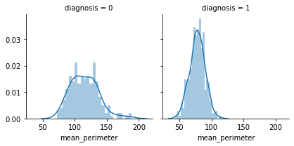
Perimeter
This variable's behavior is similar to mean_radius, when diagnosis=1 mean_perimeter is less and stacked in a small space.

Slide 10
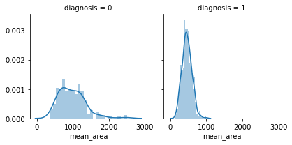
Area
Again it is similar to perimeter and radius but different from other we can see diagnosis=0 for every area

Slide 11
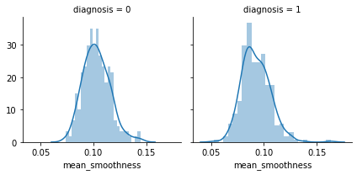
Smoothness
It is similar to texture variable. For every case of diagnosis, distribution is similar but when diagnosis is 1 it is less than other case.

Slide 12
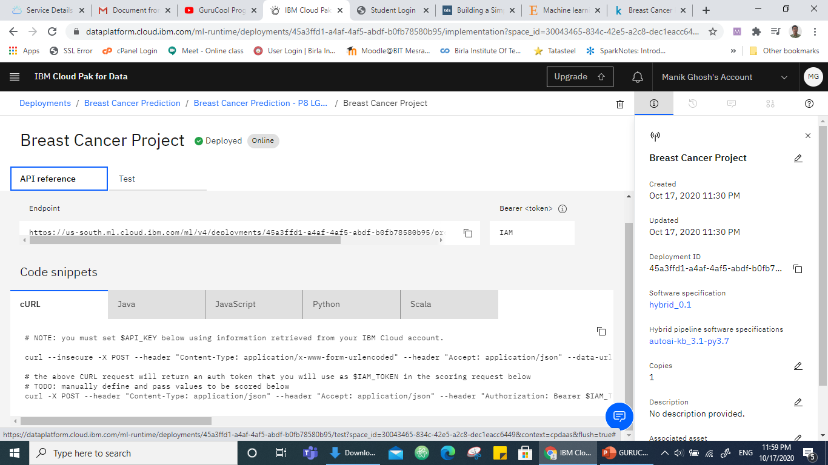

Slide 13
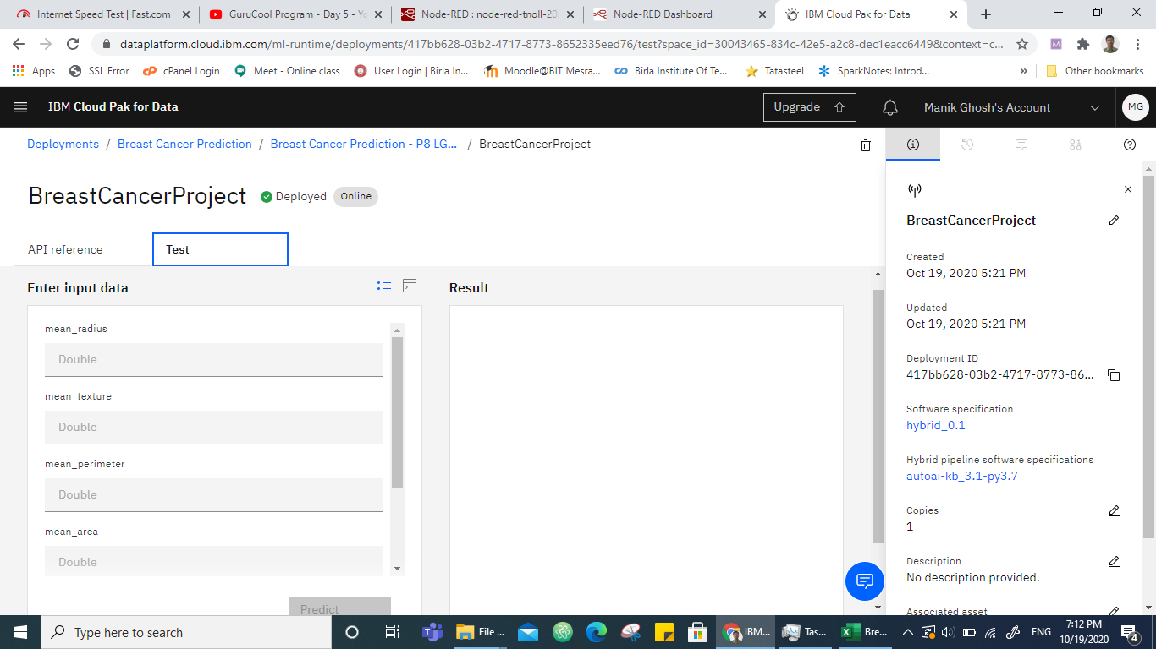

Slide 14
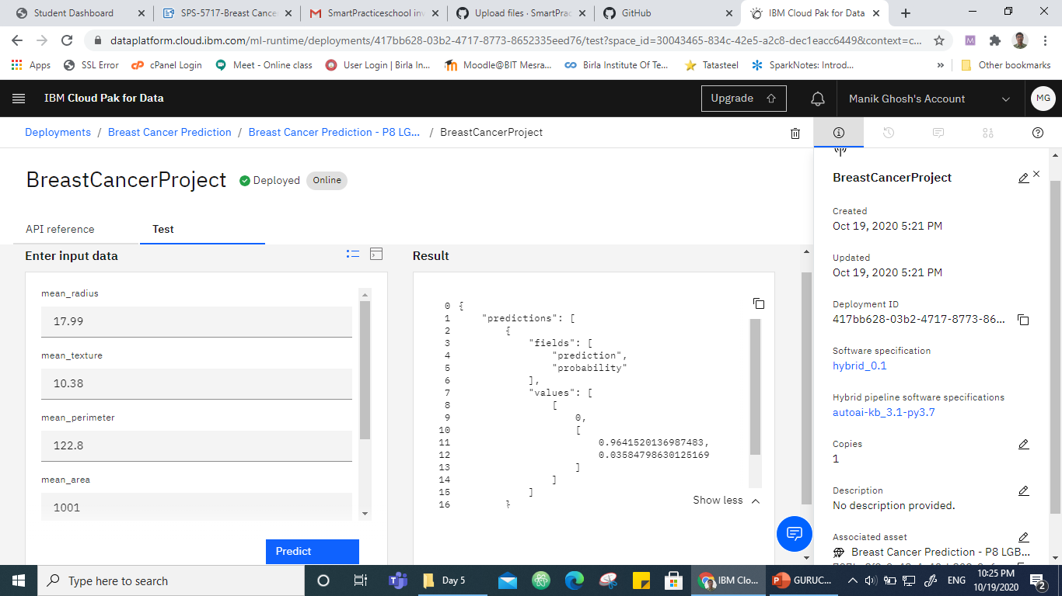

Slide 15
BreastCancerProject - Deployment
Deployment ID
417bb628-03b2-4717-8773-8652335eed76
Associate Asset
797bc8f3-9c48-4c42-b803-9e67b45be257

Slide 16
Breast Cancer Project API
Endpoint:
https://us-south.ml.cloud.ibm.com/ml/v4/deployments/417bb628-03b2-4717-8773-8652335eed76/predictions?version=2020-10-19?version=2020-09-01
API Key:
uxYXB9RuHJw7VG-vn-mg0E3eoLwmPlJWCM2SkRL54DZU

Slide 17
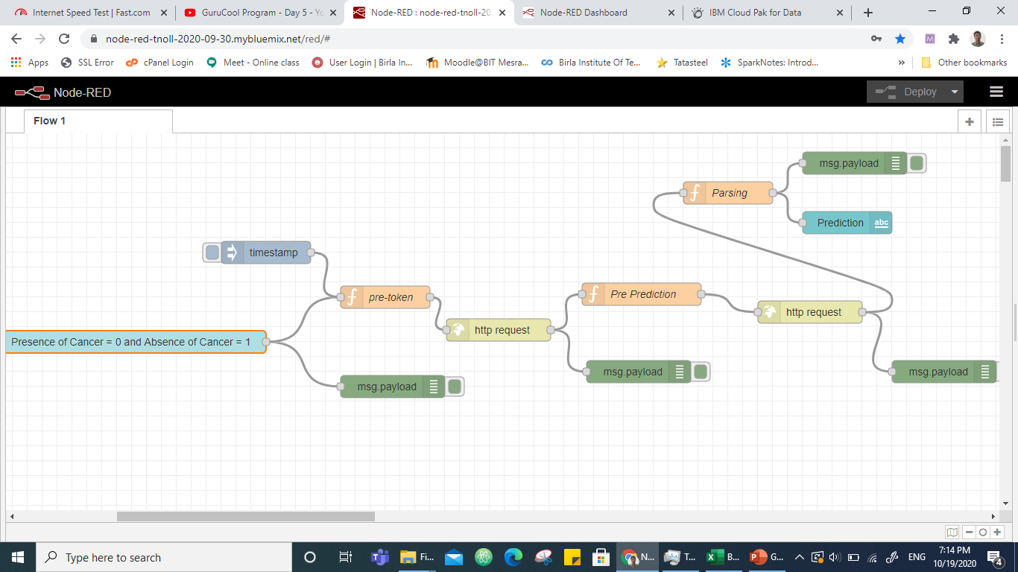
Node-Red Flow

Slide 18
Node-Red UI Link
https://node-red-tnoll-2020-09-30.mybluemix.net/ui/#!/0?socketid=yah10EoxDLzQ0NdsAAA

Slide 19
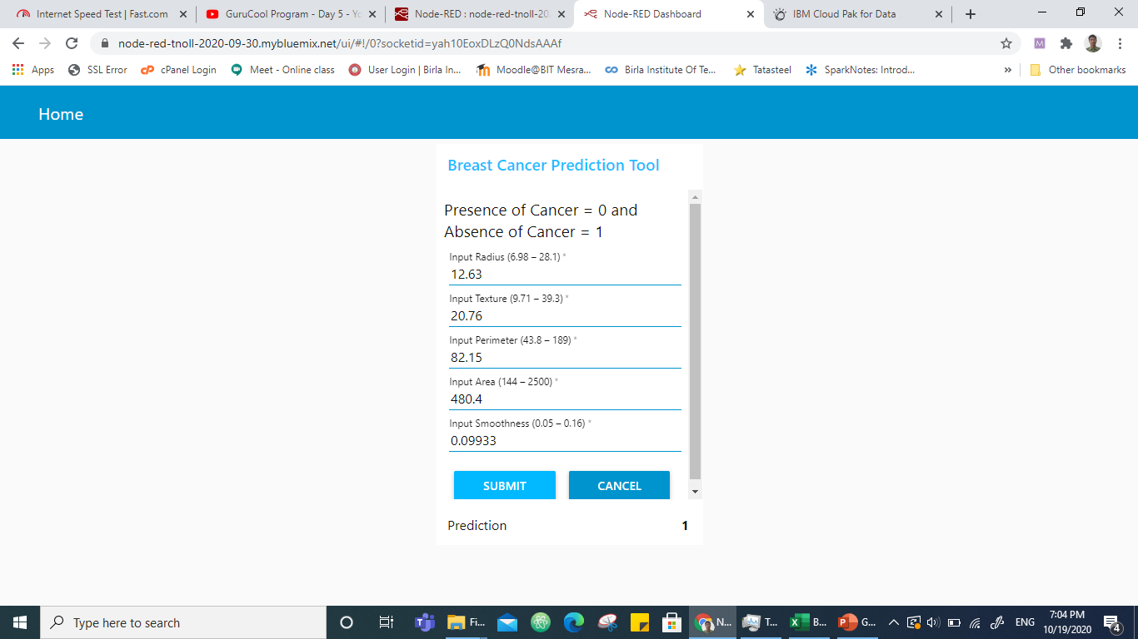
Cancer Prediction : Absence of Cancer

Slide 20
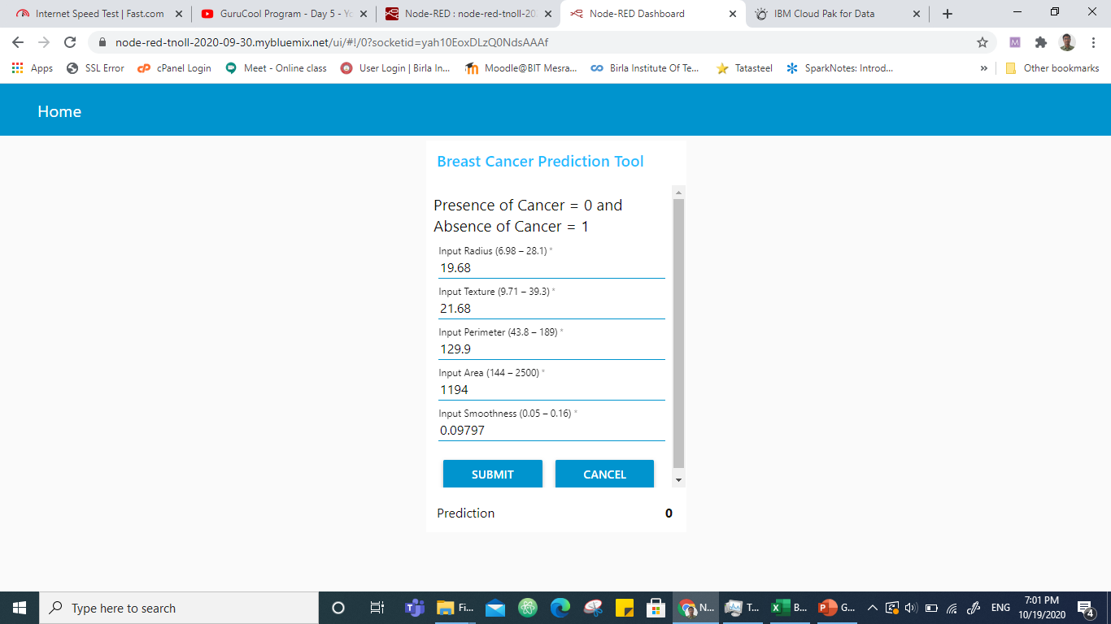
Cancer Prediction : Presence of Cancer

Slide 21
Bibliography
https://www.kaggle.com/onuralpsisman/breast-cancer-prediction
https://www.kaggle.com/merishnasuwal/breast-cancer-prediction-dataset
https://www.sciencedirect.com/science/article/pii/S2001037014000464
https://towardsdatascience.com/building-a-simple-machine-learning-model-on-breast-cancer-data-eca4b3b99fa3
https://towardsdatascience.com/breast-cancer-cell-type-classifier-ace4e82f9a79
https://rstudio-pubs-static.s3.amazonaws.com/344010_1f4d6691092d4544bfbddb092e7223d2.html
https://archive.ics.uci.edu/ml/datasets/Breast+Cancer+Wisconsin+(Diagnostic)
https://smartinternz.com/Student/badge_workspace/5717
https://www.youtube.com/results?search_query=gurucool+day+5

